Slide 1
Introduction to Privacy
Max van Arnhem – Privacy Officer
m.a.van.arnhem@bb.leidenuniv.nl

Slide 2
Overview
What is privacy even?
The GDPR
Personal data: What is?
Personal data: What do?
Anonymisation and pseudonymamimasynamysation
Common issues
Questions

Slide 3
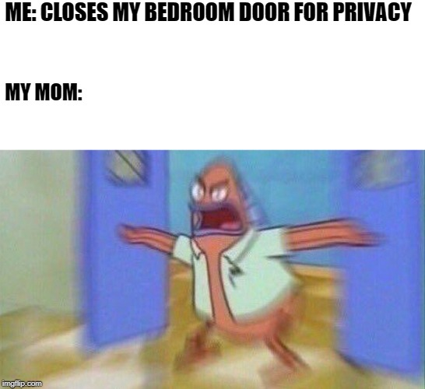
What is privacy?
A human right: to be free of interference
  Derives from right to property
  Extends to being free from interference
Where ethics and legislation meet
Agency & choice to care or not care about your privacy

Slide 4
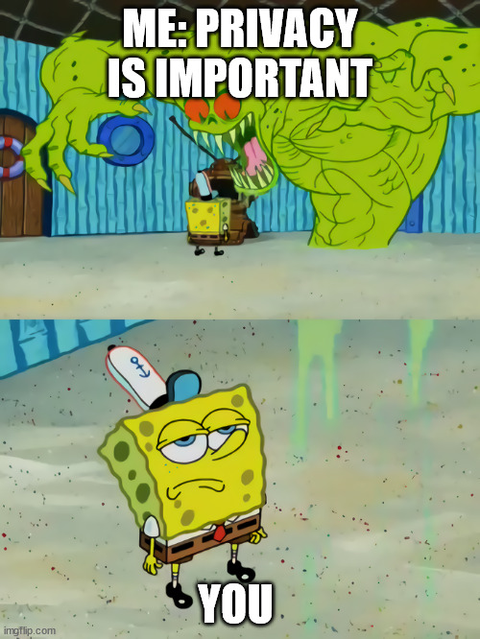
But why should I care?
Security of data, including yours
Research ethics
It’s the law
Most people only start caring about privacy after they were personally involved.
Don’t be most people.

Slide 5
The GDPR – General Data Protection Regulation
Algemene Verordening Gegevensbescherming (AVG)
Basically a way to provide tools and ways to ensure privacy rights are protected.
 | Subjects
1 | When and where does the GDPR apply?
2 | When are you allowed to process personal data?
3 | What rights to data subjects have?
4 | When are you processing personal data?
5 | Transferring data outside the EU

Slide 6
Personal data
Personal data: any information that could potentially lead to identification of an individual, directly or indirectly
Definition is broad:
Ways and tools to identify grow every day
Amount of public data increases every day
“Mosaic effect”
Exceptions: The dead, public information, the incredibly difficult to find

Slide 7

Personal data II
TLDR: Personal data is basically any information about a person
But that’s not a problem! (usually)
When can you process personal data:
1: If you have a legal ground to do so (consent or public interest)
2: If you don’t use more data than you need for your goal.
3: If you are transparent about it (to participants and the University)
4: If you treat it securely

Slide 8

Personal data III: Special Category Data
  Special category data: “sensitive” data as defined by GDPR
            Ethnic data/racial background
            Political data
            Religious data
            Trade union membership
            Genetic data
            Biometrics
            Medical data
            Mental health data
            Criminal records or history
            Sexual preference

Slide 9

Sharing, storing, transferring
Sharing, storing, transferring personal data with external parties is not allowed, unless:
Within EU?
  Need an agreement with external party(DSA, DPA, JCA)
  drafting, checking, sending and signing agreement will take time
  Not everyone is secure or privacy-proof (Google, Meta), not everyone wants to sign
Outside EU?
  Considered equivalent (e.g. Korea, Japan, Israel, Switzerland)
  Considered equivalent with restrictions (Canada, US, UK)

Slide 10

Data breaches
Data breach: Any unauthorized or illegal transfer, or acquisition of personal data.
  Lost USB-stick
  Stolen laptop
  Unauthorised transfer to external party or company
  Email sent to wrong address
  Report data breaches to the ISSC - 527 8888

Slide 11
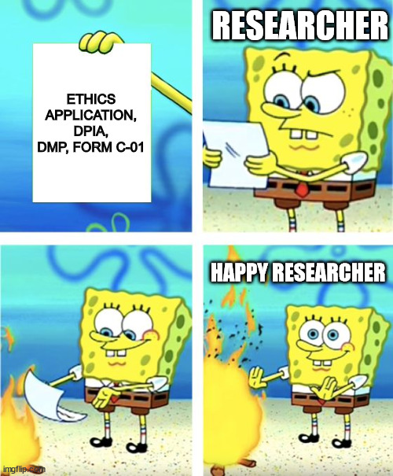
Usual procedure
  Application to Ethics committee:
          Ethics application assessed by EC
          Privacy assessment by PO
          DMP assessed by Data Stewards
  PO advises researcher, may request Data Protection Impact Assessment
  PO gives assessment to Ethics Committee
  EC gives approval/asks for changes

Slide 12
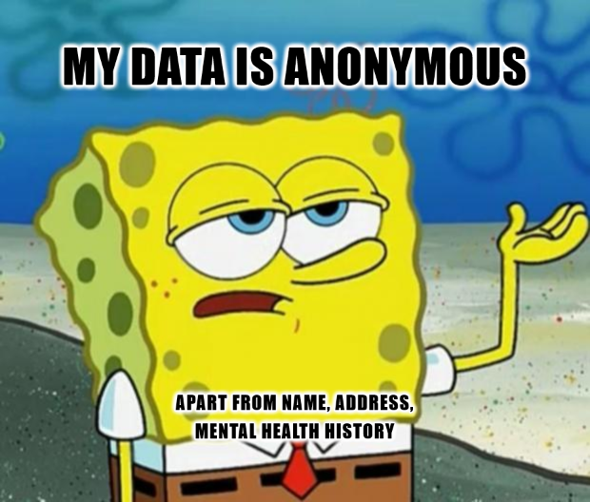
Anonymising and pseudonymising:
Pseudonymisation
Pronounce as /suːˌdɒnimablarflarpfingxque/
Anonymisation: Removing any and all personal data from a data set.
Remember: Personal data is a broad category!
Pseudonymisation: Taking steps to make it harder (but not impossible!) to identify
participants from a data set.

Slide 13
Personal data: Common pitfalls
The naughty researcher’s prayer:
“I don’t process personal data,
And if I do, it’s anonymous,
But if it isn’t, I encrypted it,
And if I didn’t, I deleted it,
And if I forgot, then it wasn’t personal data”
Processing personal data is a normal part of research. Be transparent.
Don’t obfuscate, or be hesitant to say you are processing personal data or if there are privacy risks involved. This will cost you more time and frustration.
If

Slide 14
Sharing and storing: Common issues
Basic rule: Sharing personal data with external parties is not allowed.
-This includes software platforms, apps, email apps
For example: Gmail, Gorilla, Atlas.ti, ChatGPT, WhatsApp
UL-supported software platforms & parties we have an agreement with are fine
For example: Outlook, most Microsoft apps, SURF apps,

Slide 15
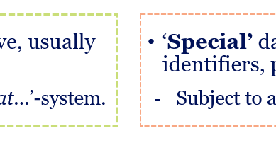
Complexity is unavoidable:
Grey areas, legalese
Other rulings and opinions by EPDB, DPO’s, UAVG
Mail me in case of doubt: privacy@fsw.leidenuniv.nl

Slide 16
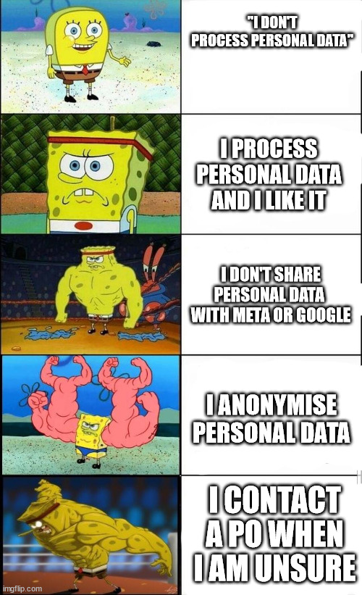
Summary
You’re probably processing personal data
Use only what you need
Be transparent
Don’t send personal data to external parties
Contact me if you have questions or concerns!
Privacy@fsw.leidenuniv.nl

Slide 17
Questions?
Email: privacy@fsw.leidenuniv.nl

