Slide 1
Practical application of the GDPR in a research setting
**-04-2023

Slide 2
Overview
What are privacy and the GDPR?
The Data Protection Impact Assessment
Identification: anonymization and pseudonymization
The Mosaic Effect, or: identification via inference
Data Sharing Agreements and Data Transfer
How does the GDPR affect me again?
The Privacy Office
Questions? privacy@fsw.leidenuniv.nl

Slide 3
1. What is privacy?
Privacy is the right to one’s own mind.
The right to be left alone.
The flow of information from and about you.

Slide 4
1. What is the GDPR?
A law at the European level.
Key phrases: identification, processing, fairness.
Chapter | Topic
1 | When and where does the GDPR apply?
2 | When may I process data, and how do I do so legally?
3 | What rights do data subjects have?
4 | Who are the processing parties and what are their responsibilities?
5 | When may I share data outside of the EU?
4

Slide 5
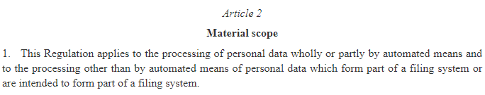
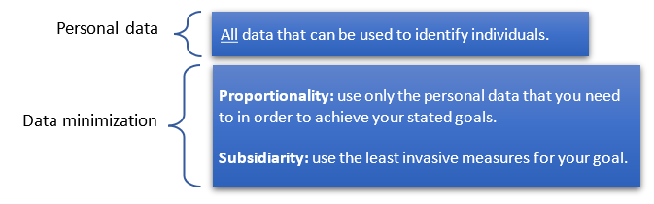
2. Identification and anonymization
5

Slide 6

2. Pseudonymization
6

Slide 7
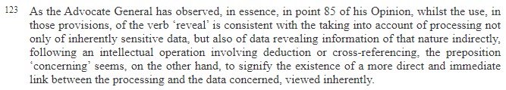
2. The Mosaic Effect - CJEU 184/20
7

Slide 8
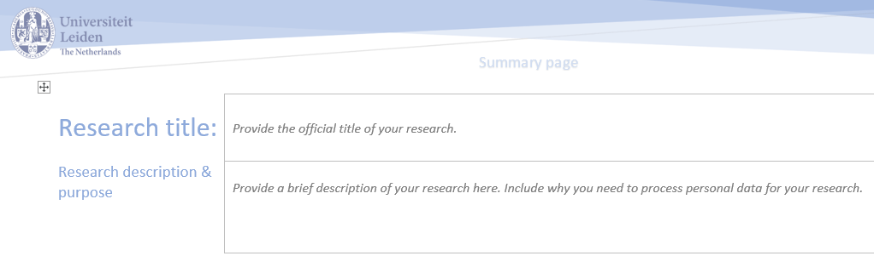
3. The Data Protection Impact Assessment
Taking inventory of compliance, risks and liabilities.
8

Slide 9
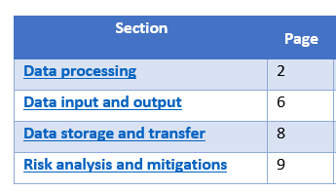
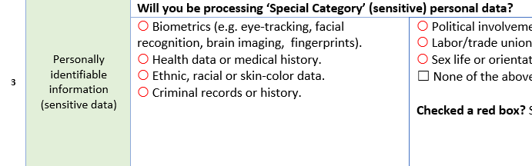
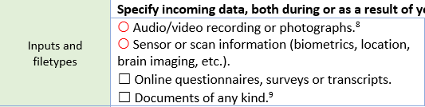
3. The Data Protection Impact Assessment
9

Slide 10
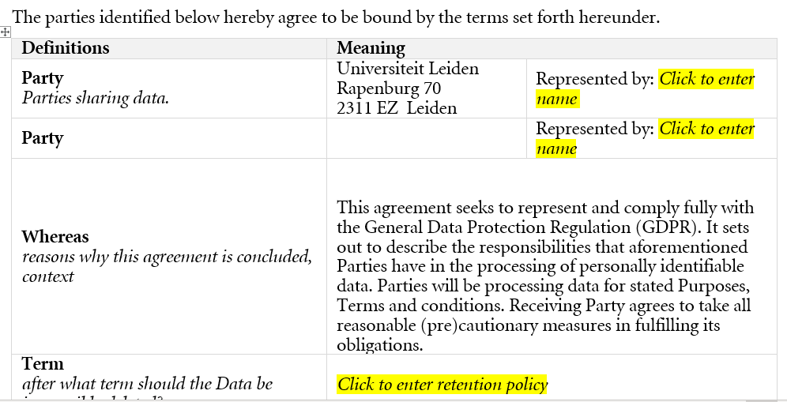
4. Data Sharing Agreements and Transfers
10

Slide 11
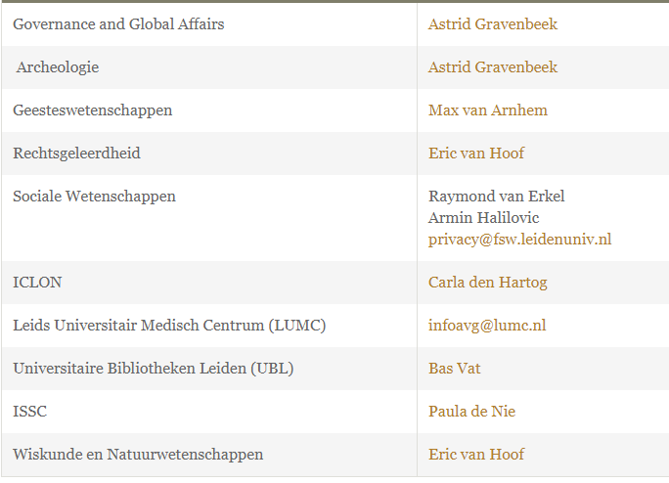
5. The Privacy Office
11

Slide 12
6. How does the GDPR affect me?
The GDPR’s fundamentals on display:
Data as a fundamental (property) right: consideration (1).
Processing rights: art. 5, 6 and 9.
Consent: art. 7.
Integrity: art. 5(1)(d).
Confidentiality: art. 5(1)(f).

Slide 13
6. Examples
A few example cases. What problems could you see arising?
  Study in China, where Chinese participants are studied.
  Study in which extent and moment of anonymization is unclearly conveyed.
  Researcher wants to use data from their own previous study.
  Researcher wants to use Amazon-recruited survey-takers.
  Researcher wants to share data with other university or organization.
  Researcher wants to use US-based service.

Slide 14
7. In summary
  Privacy
  Identification, anonymization and pseudonymization
  Data privacy – impact and risk
  Data transfers
  Who are we and how can we help

