Slide 1
If the data is not meant to be openly accessible, please add a password to it
&
send the password to us at datastewards_psy_ped@fsw.leidenuniv.nl .

Slide 2
How to password-protect files
You can zip a files or folder and add a password to it with 7zip
If you don't have 7zip you can download it in the software center
Right-click on the file/folder and choose 7zip, choose "Add to archive..." And enter a password.
Don't use your ULCN password! Choose a unique password for every study.

Slide 3
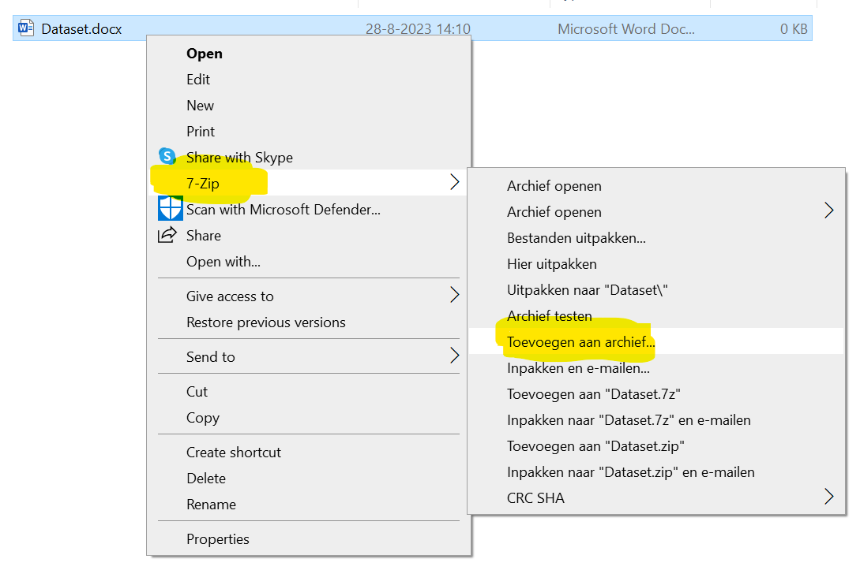

Slide 4
