Slide 1
BehSci PhD training:
Data Archiving Guidelines
Willemijn Plomp & Jaap-Willem Mink | Data Stewards Behavioural Sciences
Mail: datastewards_PSY_PED@fsw.leidenuniv.nl

Slide 2
Data Management Policy Leiden University
BEFORE
Write a data management plan (DMP) at the start of your PhD
(PSY: once per PhD, IPW: once per project)
Securely store your data to prevent data loss and protect participants' privacy
Prepare to be FAIR (consider which data can be shared, write documentation)
Update your DMP when necessary
DURING
Make a publication package (Data should be FAIR, minimum 10 years)
Keep a copy of your data on university network (J:Drive)
The data stewards will archive your DMP
AFTER
https://www.organisatiegids.universiteitleiden.nl/en/regulations/general/leiden-university-data-management-regulation

Slide 3
Why archive and share research data?
?

Slide 4
Why archive and share research data?
National Guidelines & Open Science policy
Funder and journal requirements
Prevents data loss and lets you retrace your steps
Integrity and transparency
Reproduce results and replicate experiments
Reuse data
Reuse code, materials, software
Get more citations when people reuse your data

Slide 5
When do you need to archive and share your data?
You are the first author and the data are stored on a Leiden University Server
Published empirical studies
Empirical studies appearing in (unpublished) PhD thesis chapters
PSY research master theses
→ A ‘Publication Package’

Slide 6
What is a Publication Package?
All the materials necessary to replicate the study, reproduce the results and reuse the data.
Archiving instructions can be found on website and Teams!
Our own README-file template can be found here!
Check out our monthly workshops.
1) Preprint or paper
2) Materials, instructions, procedures
3) Raw data
4) Computer code for data analyses
5) Processed data
6) Data management plan
7) README file
8) Approved ethics protocol
9) Preregistration

Slide 7
Sharing Sensitive Data
To protect your participants' privacy, don't include:
  Participant's names, email addresses, etc.
  Conversion key (document that links participants to their code)
  Videos or photographs of participants (in most cases)
  In-depth interviews that cannot be de-identified
Make the data less sensitive:
  Age instead of date of birth, age categories instead of absolute age
  Transcripts instead of video/audio files
  Deface MRI images
  If possible, remove identifiable variables

Slide 8
Where do we archive and share the publication packages?
Data repository:
Online platform for sharing data
Cite your data by supplying a persistent identifier
Facilitate discovery of your data
Make your data more valuable for current and future research
Preserve your data for the long-run
Leiden usually recommends using DataverseNL (dataverse.nl)

Slide 9
Details about DataverseNL
Once a publication package has been uploaded by the data stewards it will be available for at least ten years.
Data files can be max 10GB, entire dataset can be max 1TB.
You can choose to set each file as Open, Upon Request and Closed. (Most PSY/IPW data are upon request)
Persistent identifier => Permanent link. This makes the publication package citable. (You can also ask for this permanent link earlier, so you can include it in your paper)

Slide 10
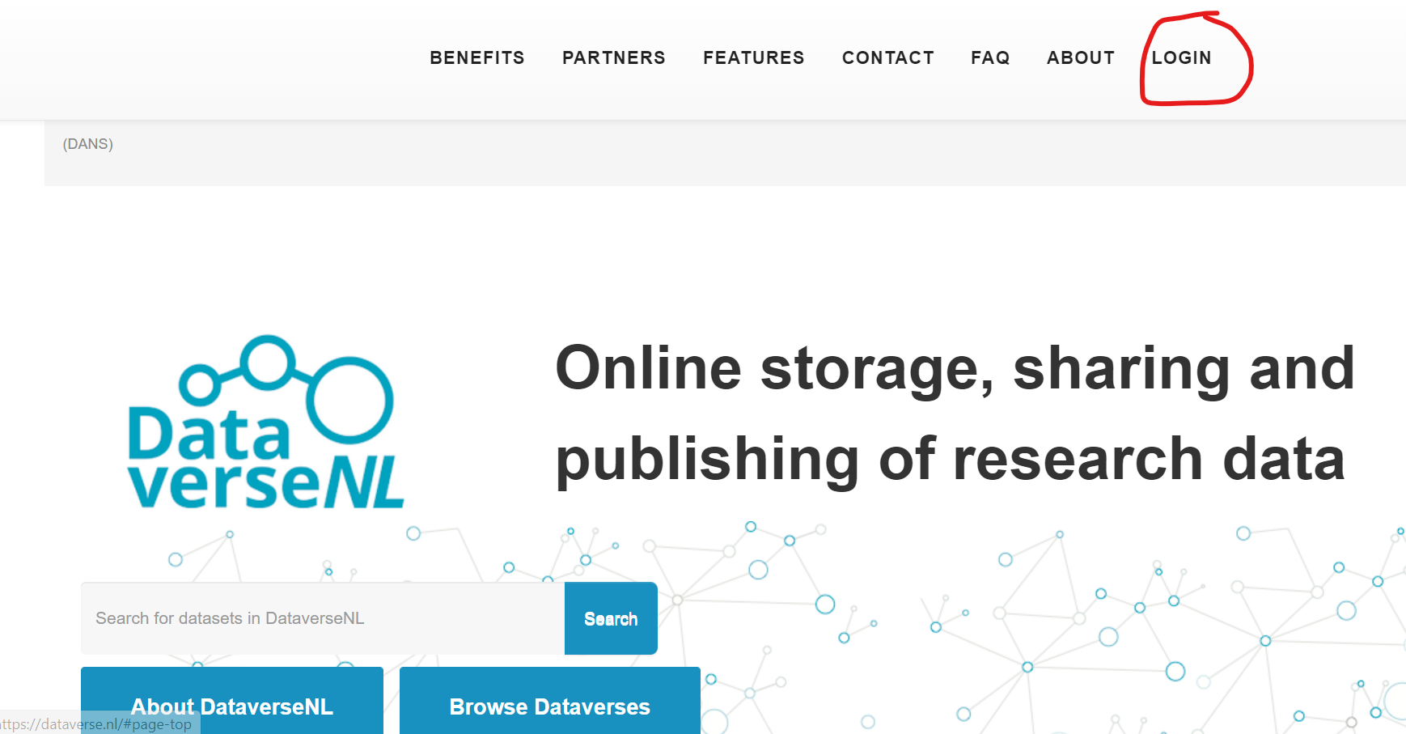
Quick look at DataverseNL
Click “Log in” and choose “Institutional Login”
https://dataverse.nl/

Slide 11
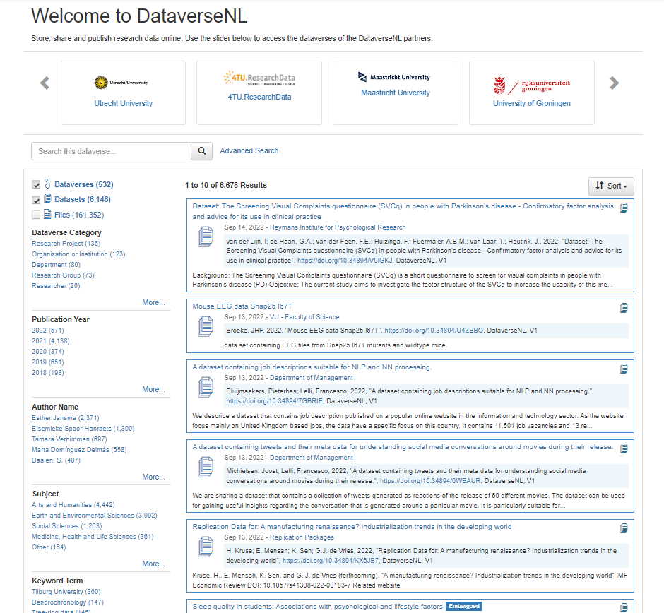
Search by:
Title
Keywords
Authors
University/institution
Year

Slide 12
Other places to find data
Google Dataset Search: https://datasetsearch.research.google.com/
Open Science Framework: https://osf.io/
Open Neuro: https://openneuro.org/

Slide 13
Questions?

Slide 14

Open Science Community Leiden
Learn from peers and from other disciplines;
your colleague down the hallway may have hands-on experience, your colleague from another faculty may tell you how their field solved an issue.
Discuss and stay updated with recent advances;
there are a lot of new practices and terms and keeping up is both necessary and time-consuming.
Mentor others;
there are always people who are newer to things than you—help them, together we can create a more transparent and therewith faster evolving science.
Twitter: @oscleiden
Mail: oscl@leidenuniv.nl
Teams: OSCL Teams or via
www.universiteitleiden.nl/open-science-community-leiden

Slide 15
Closing and Assignments
2nd session:
Friday October 11th
Before session 2, send your questions about privacy and handling personal data to privacy@fsw.leidenuniv.nl
Time | Subject
11:00 – 11:30 | Information for new Psychology PhD's
11:30 – 11:35 | Break
11:35 – 12:35 | Privacy and Personal Data
12:35 – 13:00 | End, ask questions about your DMP and DPIA

Slide 16
Closing and Assignments
3rd Session: on Friday November 8th, you will present your DMP (7 minutes max., see programme) and receive feedback. You will be assigned to a group in a next email.
  Slide 1: presentation of your project and your research data
  Slide 2: presentation of your data management
  Slide 3: lessons learnt and challenges.
Before October 25th, please send your data management plan (use this template) to datastewards_psy_ped@fsw.leidenuniv.nl.
If you have Powerpoint slides (optional): we would like to receive them two days in advance (by November 6th).

Slide 17




Read more…
Open Science - Leiden University (universiteitleiden.nl) or the Research Data Management channel on IPW Teams -this pages contains Leiden Behavioural Science templates for DMPs and Publication packages as well as information about Open Science good practices.
MRI Data Sharing Guide - this flowchart helps you think about whether, and how, you can share your MRI data
Expert tour guide on data management by Consortium of European Social Science Data Archives. A reminder of basic principles of RDM from an international perspective
What is pseudonymous, de-identified or anonymous data?
A Visual Guide to Practical Data De-Identification
Klein, O., et al. (2018). A Practical Guide for Transparency in Psychological Science. Collabra: Psychology, 4(1): 20. DOI: https://doi.org/10.1525/collabra.158
And the guide itself: https://psych-transparency-guide.uni-koeln.de
Better coding for reproducible research 10.5281/zenodo.13644575
Data Documentation Initiative (DDI): an international standard for describing the data produced by surveys and other observational methods in the social, behavioral, economic, and health sciences (useful to some but needs slightly more advanced skills)) https://ddialliance.org/training/getting-started
FAIR Aware: https://fairaware.dans.knaw.nl/
CESSDA Data Management Expert Guide: https://dmeg.cessda.eu/Data-Management-Expert-Guide

Slide 18
Thank you for listening!

