Slide 1
BehSci PhD training:
Data Management Planning
Willemijn Plomp & Jaap-Willem Mink | Data Stewards Behavioural Sciences
Mail: datastewards_PSY_PED@fsw.leidenuniv.nl
Based on a presentation by
Fieke Schoots, Joanne Yeomans &
Sander Nieuwenhuis

Slide 2
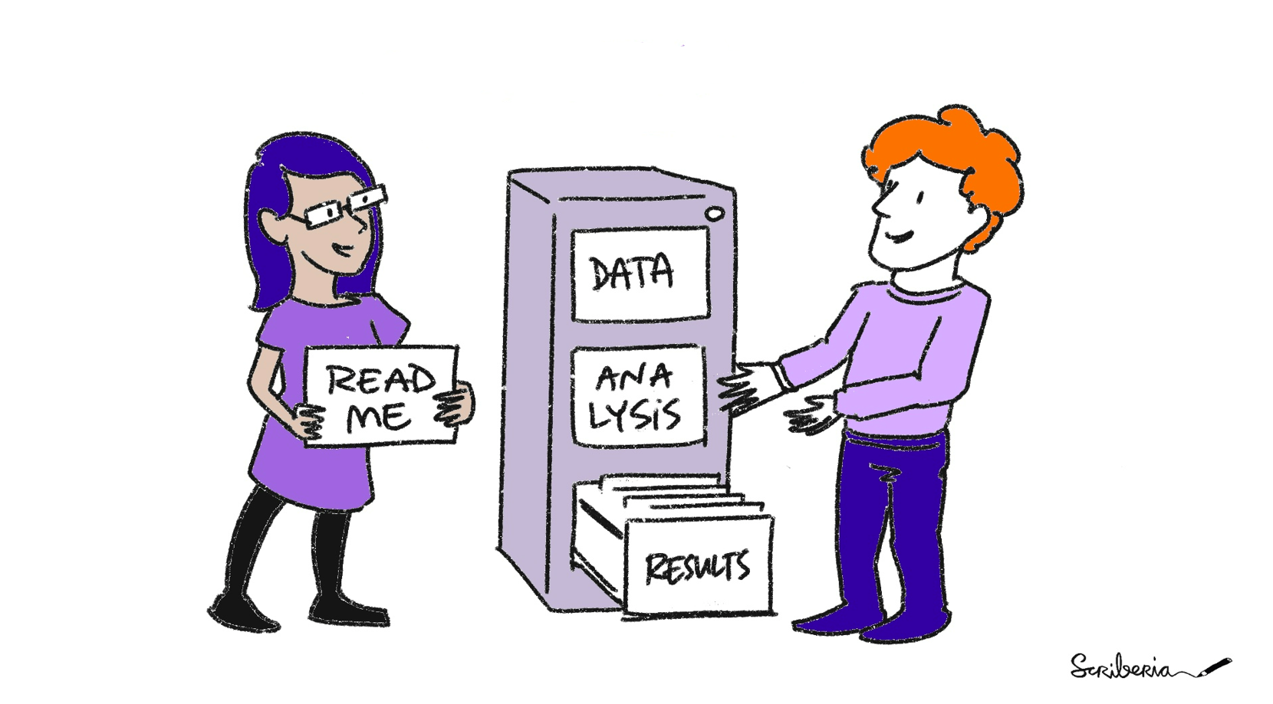
Introduction - What do Data Stewards do?
    We can help you with…
Data Management Plans (DMPs)
Publication Packages
Data management information, for example:
  Where to store data?
  How to share data?
  How to reuse data?
  Contact us per mail (datastewards_psy_ped@fsw.leidenuniv.nl) or visit us during our Open Office Hours (Tuesdays 13:00 – 15:00 in 4A22)

Slide 3
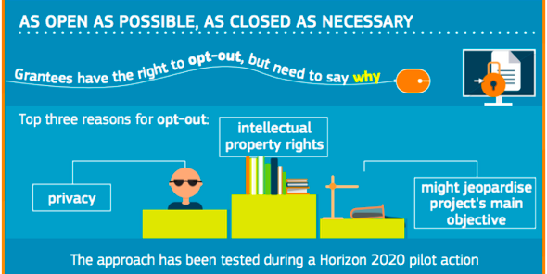
The aim of the University, and many funders, is to produce data that is:
Writing a data management plan (DMP) can help you achieve this.

Slide 4
Data Management Plan (1)
The Data Management Plan is a formal document that describes the data you will produce in the course of your research project.
It should clearly outline how the data will be collected, stored, protected, preserved and shared.
Writing a Data Management Plan will encourage you to think carefully about the data management needs of your research data and plan accordingly.
Write as clearly as you can.

Slide 5
Data Management Plan (2)
Write it to summarize your decisions at this time.
As new tools become available, or as the situation changes so your research methodology changes, update your DMP and make a new version.
Plan to be “As open as possible, as closed as necessary”.
The earlier you can decide how you will share and preserve your data, the better you can prepare.
Note: in PSY one DMP is made for the whole PhD track, in IPW one DMP is made for every project.

Slide 6
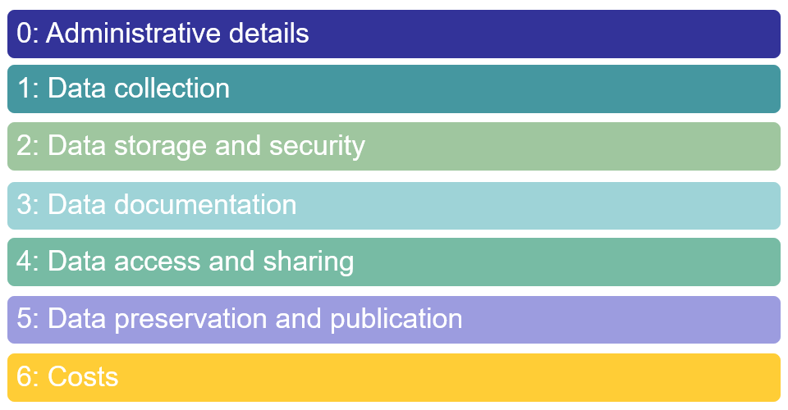
DMP at Leiden University

Slide 7
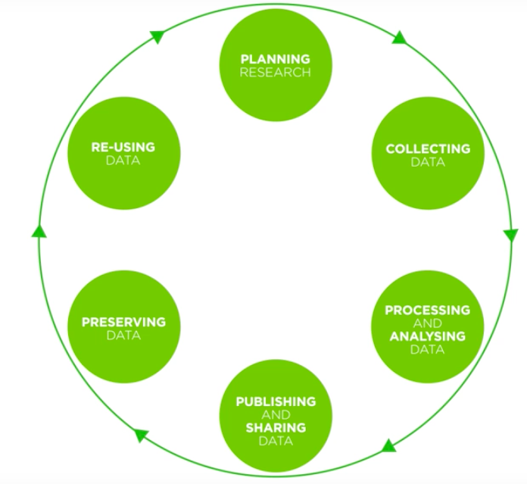





DMP and research data life cycle (1)
You are (probably) here
Image: http://www.ukdataservice.ac.uk/manage-data/lifecycle.aspx

Slide 8
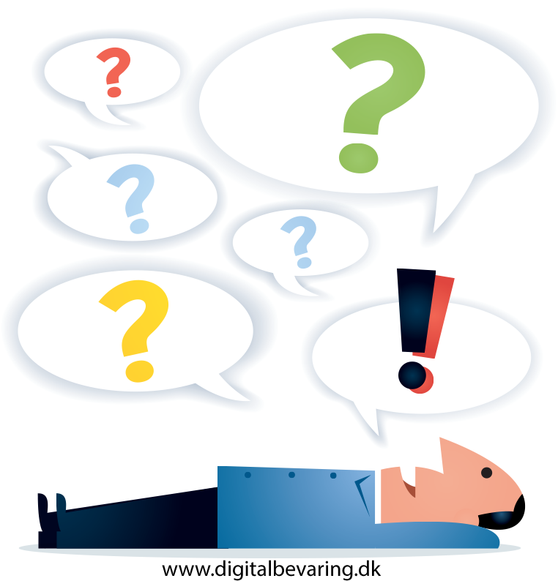
DMP and research data life cycle (2)
Explore existing data (under what conditions can I use it?), design data collection process
What do YOU DO in each of these stages?
What do you need to think about?
Download data, interview people. Do I have enough storage?
How will others cite my data? Discuss with my supervisor how we will both access my data after I leave. Who may want to use my data?
Check, validate, clean, organise, pseudonymize. Do I also need to keep the original files? Perform statistical analyses.
Choose archive, select and delete files, migrate to sustainable format.
Contact data stewards. Prepare packages to accompany articles; create user documentation. What licence should I choose?
Image: http://www.ukdataservice.ac.uk/manage-data/lifecycle.aspx
https://youtu.be/-wjFMMQD3UA

Slide 9
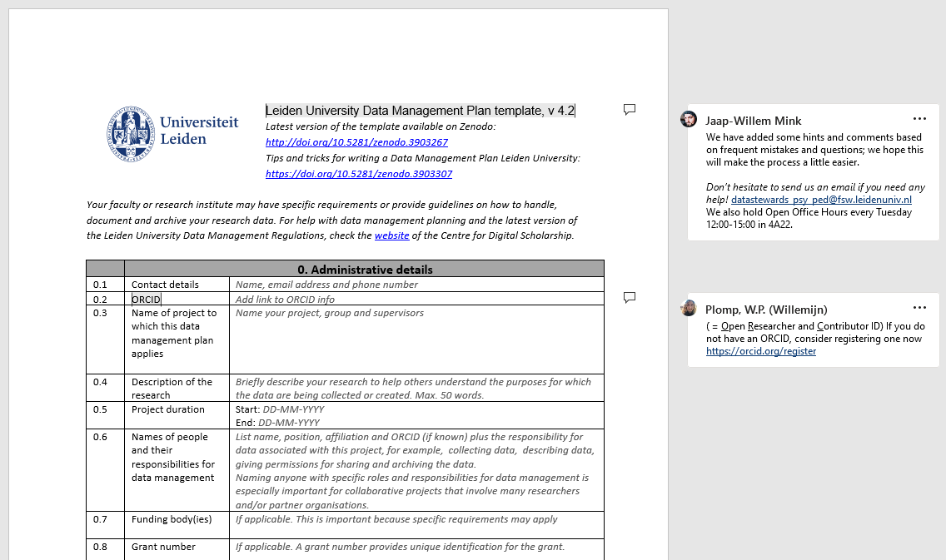
Template and link
💡 You can find our up-to-date empty DMP template on Zenodo:
https://zenodo.org/record/7657110

Slide 10
0. Administrative details
Description of your research
Are you working with any other organisations?
Are you collecting personal data?

Slide 11
1. Data collection
What types of data will you collect?
Will you reuse existing data?

Slide 12
2. Data storage and security
Where will you store the data during the project?
What are the main risks to your data security during your research?
  Accidental file deletion
  Losing hard drives or cameras
  Harm to participants if the data is leaked

Slide 13
2. Data storage and security
What measures will you take to mitigate these risks?
  Don't collect more personal data than necessary
  Don't keep personal data on personal computers
  Give students restricted access
  Know what to do in case of a data breach

Slide 14
3. Data documentation (1)
File and folder naming
Meaningful and consistent
It should be clear to what project a file belongs, who the PI was and when the file was created
  Eg., 20230906_Plomp_PhD-training_V1.ppt (or add this information in a separate text file)
Keep folder names short and simple

Slide 15
3. Data documentation (2)
Keeping track of multiple versions
Lock raw data (so you don't accidentally mess with it!)
Version number in file name
Save SPSS script when making changes
Keep a logbook (text file), write down the changes per version

Slide 16
3. Data documentation (3)
Metadata (data about data)
Descriptive and administrative metadata about your dataset (when archiving).
What does someone need to know about your dataset to use it:
  Who created your data
  What the dataset contains
  Where it was created
  When it was created
  What software is needed to interact with the data

Slide 17
3. Data documentation (4)
Metadata (data about data)
This metadata is usually described in a “README”-file.
Other items that can help document your data:
  Codebooks (describe the variables you collected)
  Materials you used (questionnaires, procedures, instructions)
  ?
💡 You can find our README template on Zenodo:
https://zenodo.org/records/7113206

Slide 18
4. Data access and sharing (1)
Sharing data during your project
If sharing data with another research group or outside organization, consider:
  What will you share with them? (e.g., all data, only de-identified data, no copyrighted interview guides)
  Under which conditions will you share with them? (e.g., must give me credit on any resulting papers, must delete data after use)

Slide 19
4. Data access and sharing (2)
Consent forms
Don't promise to destroy the data after the project
Explain to the participants:
  What data you will collect and share
  With whom and for what purpose you will share them
💡 Templates for Informed Consent, Debriefing and Information letter can be found here (PSY) and on the IPW Teams

Slide 20
5. Data preservation and publication (1)
Archiving and sharing data after your project
Which parts of your project can you share open access/upon request/ cannot be shared?
e.g., for privacy or copyright reasons
What will you do to prepare your data for archiving and sharing?
  De-identification
  File formats (e.g., .csv instead of .sav)

Slide 21
5. Data preservation and publication (2)
How will you allow others to reuse your data?
A license tells other researchers what they are allowed to do with your data. Choose a license here: https://chooser-beta.creativecommons.org/
Access levels determine how easily someone can download your data: Open, Upon request and fully Closed.
(Most PSY/IPW data are shared Upon Request)

Slide 22
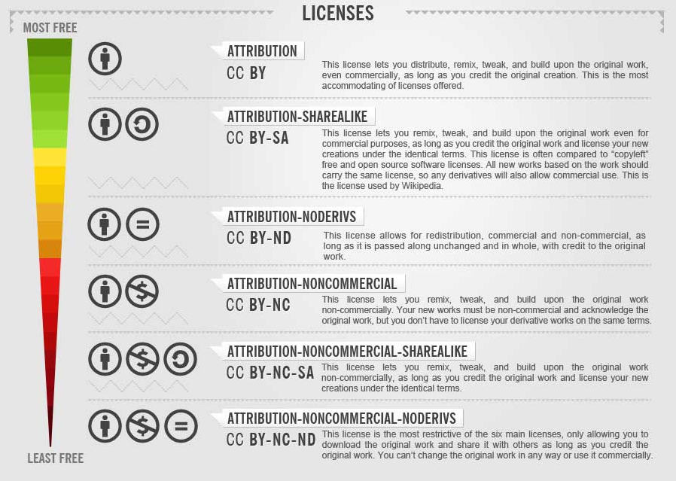
5. Data preservation and publication (3)
💡 Regarding licenses: We recommend being as open as possible using CC0 or CC-BY.
(Creative Commons Infographic from: Technology Enhanced Learning Blog)

Slide 23
6. Costs
Storage costs (mostly) covered by the University
Extra costs might arise when traveling or for large (> 1Tb) data sets (video, MRI data, etc)
In rare cases you may need to hire someone to curate your data (e.g., GUTS, L-CID)

Slide 24
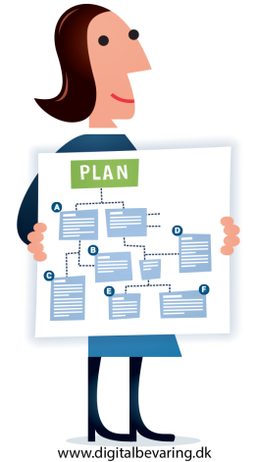
Tools, tips, and templates
      Leiden Data Management Plan
            Template: https://doi.org/10.5281/zenodo.7657110
            Tips: https://doi.org/10.5281/zenodo.3903307
            This template is accepted by most funders.
      Online tools with public DMPs
            DMP online: https://dmponline.dcc.ac.uk/
            ARGOS: https://argos.openaire.eu/home

Slide 25
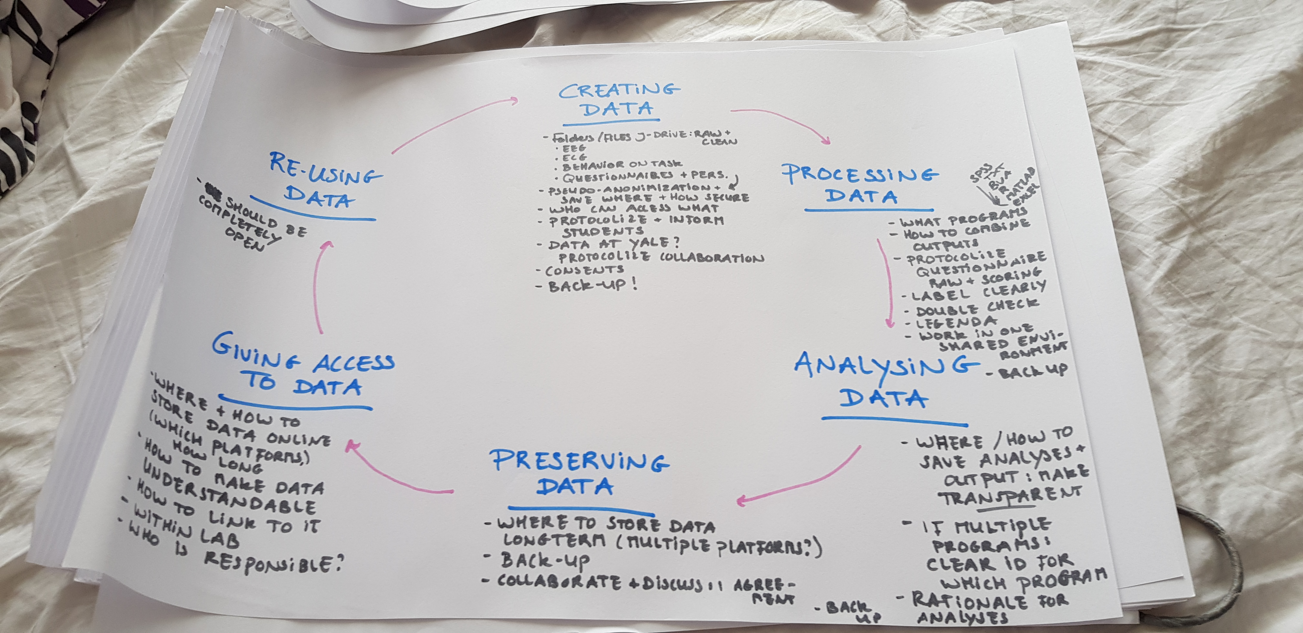
Your research data life cycle
What do YOU DO in each of these stages?
What do you need to think about?

Slide 26
Thank you for listening!

