Slide 1

Research data management training
Introduction
Femmy Admiraal | Centre for Digital Scholarship
Psychology / Education & Child Studies
27 September 2024

Slide 2
Program
Time | Subject | Details | By
11:00 – 11:45 | Introduction | Welcome and Introduction to data management Getting to know each other FAIR data | Femmy Admiraal
11:45 – 12:15 | FAIR data | Hands-on exercise | Femmy Admiraal
12:15 – 12:30 | Break
12:30 – 13:10 | Data management planning | Data Management Guidelines | Jaap-Willem Mink and Willemijn Plomp
13:10 – 13:30 | Research Life-cycle | Hands-on exercise | Femmy Admiraal
13:30 – 14:00 | Break
14:00 – 14:40 | RDM at FSW Leiden | Data Archiving Guidelines | Jaap-Willem Mink and Willemijn Plomp
14:40 – 14:50 | Closing and assignment | Preparation for the next sessions on September 29th and October 20th | Jaap-Willem Mink and Willemijn Plomp
UBL | Centre for Digital Scholarship

Slide 3
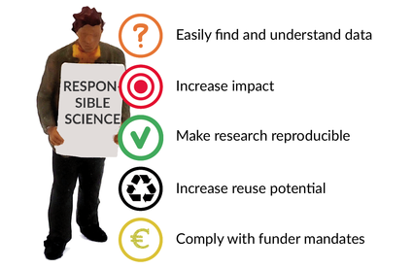
Why talk about research data management?
Image by Verbeelingskr8 in:
CESSDA Training Team (2017 - 2019). CESSDA Data Management Expert Guide. Bergen, Norway: CESSDA ERIC.
Retrieved from https://www.cessda.eu/DMGuide
UBL | Centre for Digital Scholarship

Slide 4
Learning objectives
By the end of this course you will:
Have considered the basic principles of good research data management (RDM).
Know what is meant by “FAIR” data.
Have discussed how to deal with personal and sensitive data.
Know what is required by the university in terms of managing, documenting and sharing your research data.
Have written a data management plan (DMP).
UBL | Centre for Digital Scholarship

Slide 5
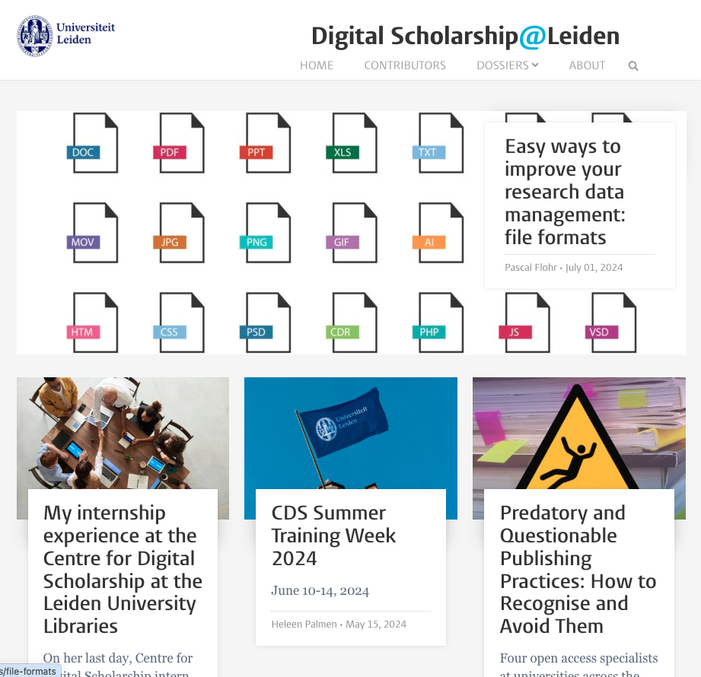
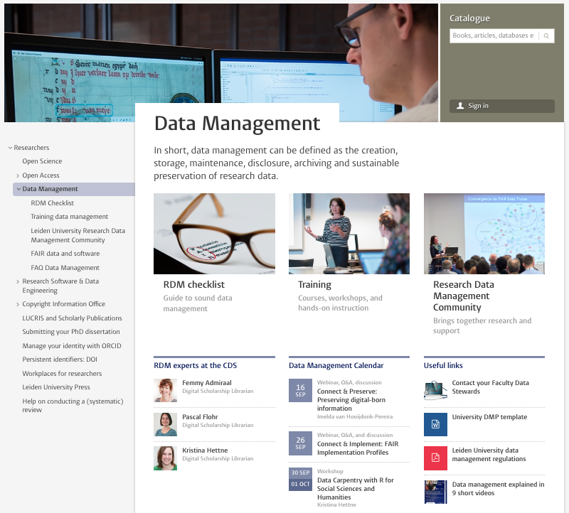
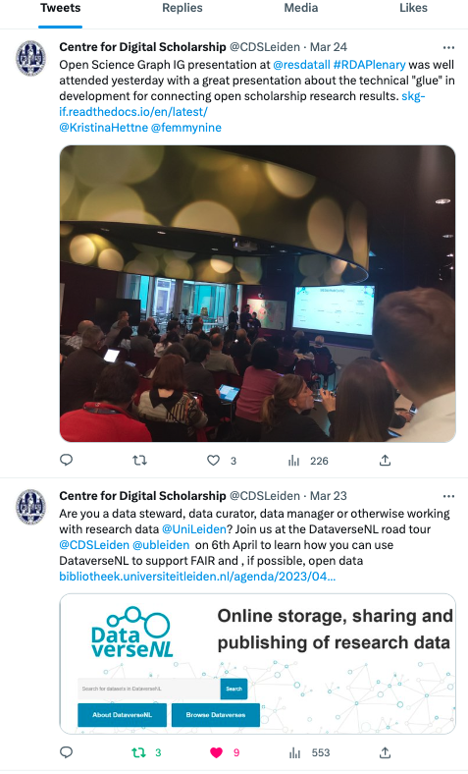
Centre for Digital Scholarship
https://www.library.universiteitleiden.nl/researchers/data-management
UBL | Centre for Digital Scholarship

Slide 6
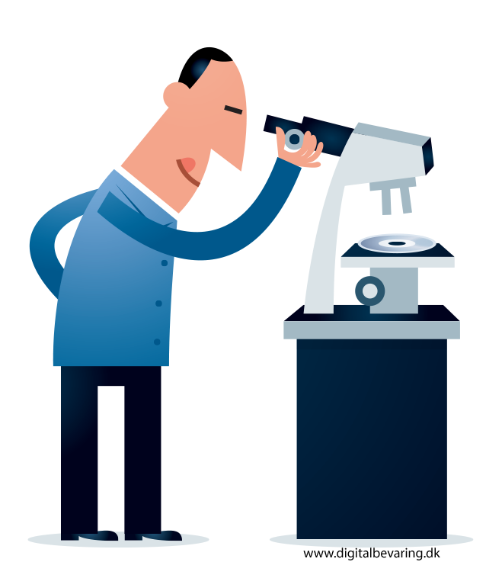
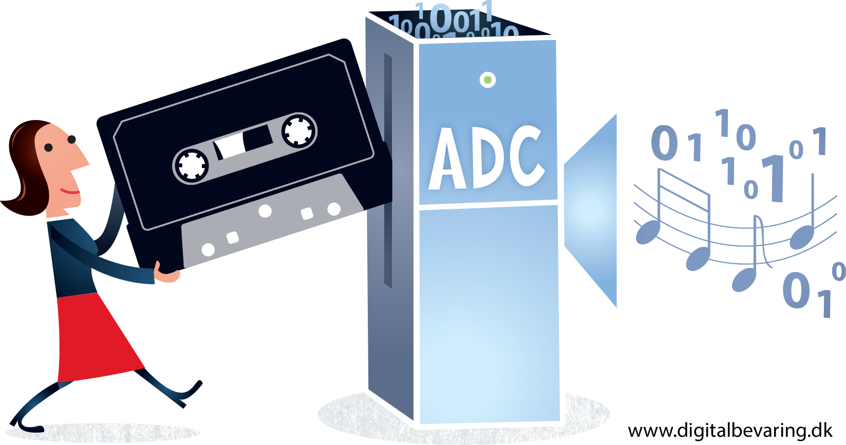
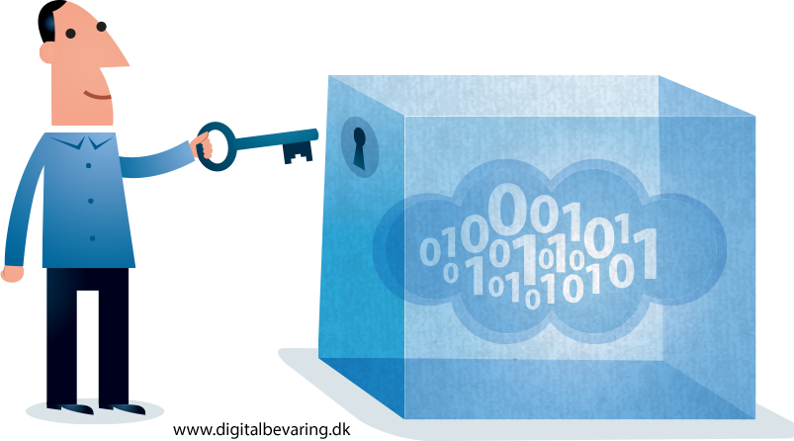
Research data…
… is any information collected or generated for the purpose of analysis, in order to generate or validate scientific claims.
Raw data you create or new results you produce;
Data you (re)use created by others;
Data on which you test your model or theory;
Qualitative data such as interviews or surveys.
UBL | Centre for Digital Scholarship

Slide 7
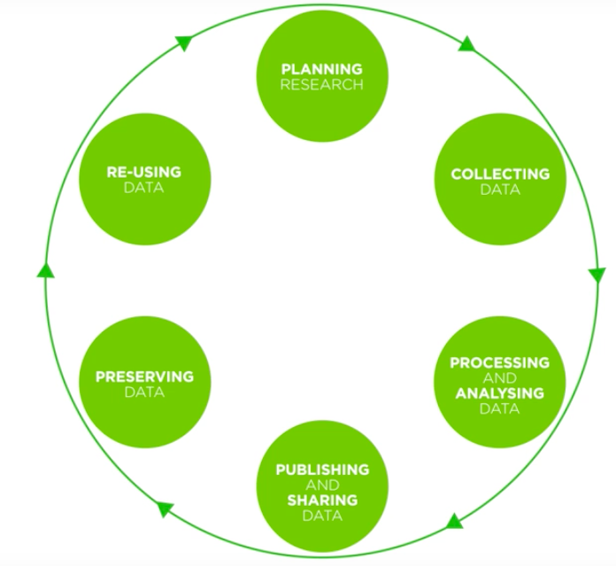
RDM in the research data life cycle
You are (probably) here
UBL | Centre for Digital Scholarship

Slide 8
RDM in the research data life cycle
DMP6: Costs
A data management plan (DMP) encourages you to think beyond your current stage and plan for later.
***
It is easier to produce verifiable & re-usable data if you plan for this from the start.
DMP1: Data collection
DMP5: Data preservation and publication
DMP2: Data storage and security
DMP4: Data access and sharing
DMP3: Data documentation
UBL | Centre for Digital Scholarship

Slide 9
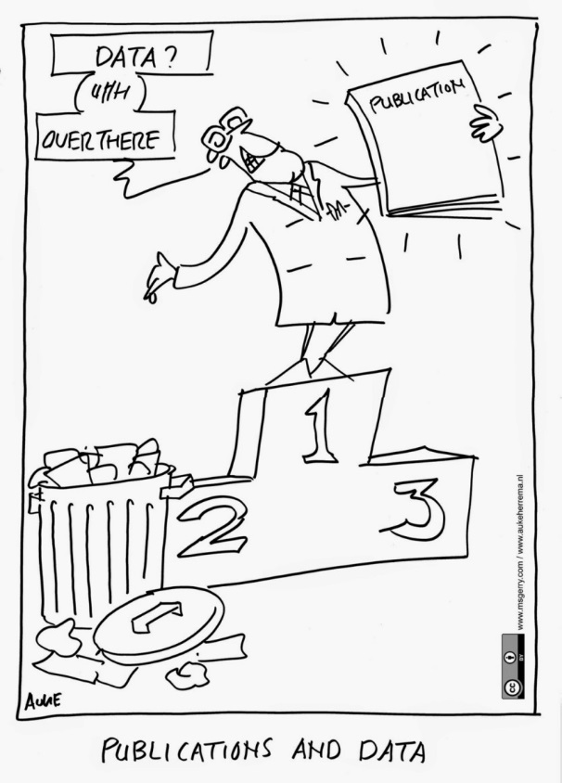
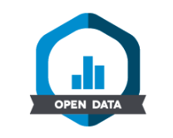

In summary
The aim of good RDM is that research data is treated not as a by-product of research but as a first-class research output.
Good RDM takes some effort and time but brings benefits to the researcher, to science, and to society at large.
UBL | Centre for Digital Scholarship

Slide 10
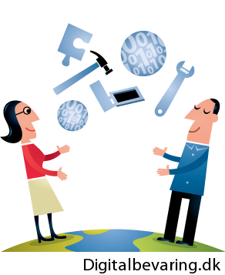
How about YOUR research data?
You will probably have a unique set of RDM challenges
But you may have challenges in common with others
What kind of data and RDM challenges do you have?
What do you hope to learn in this course?
Digitalbevaring.dk [CC BY 2.5 Denmark (https://creativecommons.org/licenses/by/2.5/dk/)]
UBL | Centre for Digital Scholarship

Slide 11
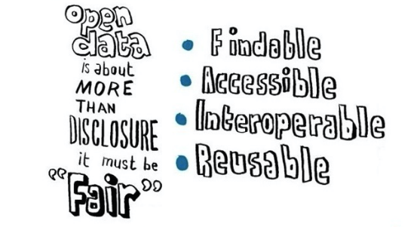
FAIR data
Findable
By both humans and machines
Include metadata that allow the discovery of interesting datasets
Accessible
Stored for long term with technical access and well-defined legal conditions
Open if possible
Interoperable
Ready to be combined with other datasets
Reusable
Ready to be used for future research
Read more about FAIR:
https://www.library.universiteitleiden.nl/researchers/data-management/fair-data
UBL | Centre for Digital Scholarship

Slide 12
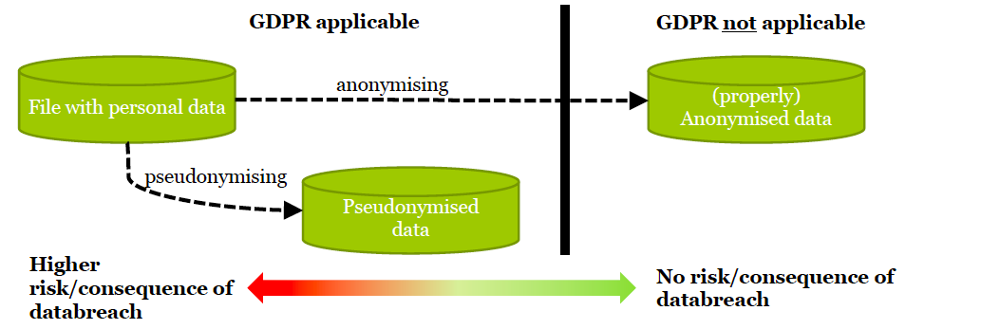
FAIR data is not Open Data!
  “as open as possible, as closed as necessary”
Picture by Mark van Leeuwen, FGGA / ISSC
UBL | Centre for Digital Scholarship

Slide 13
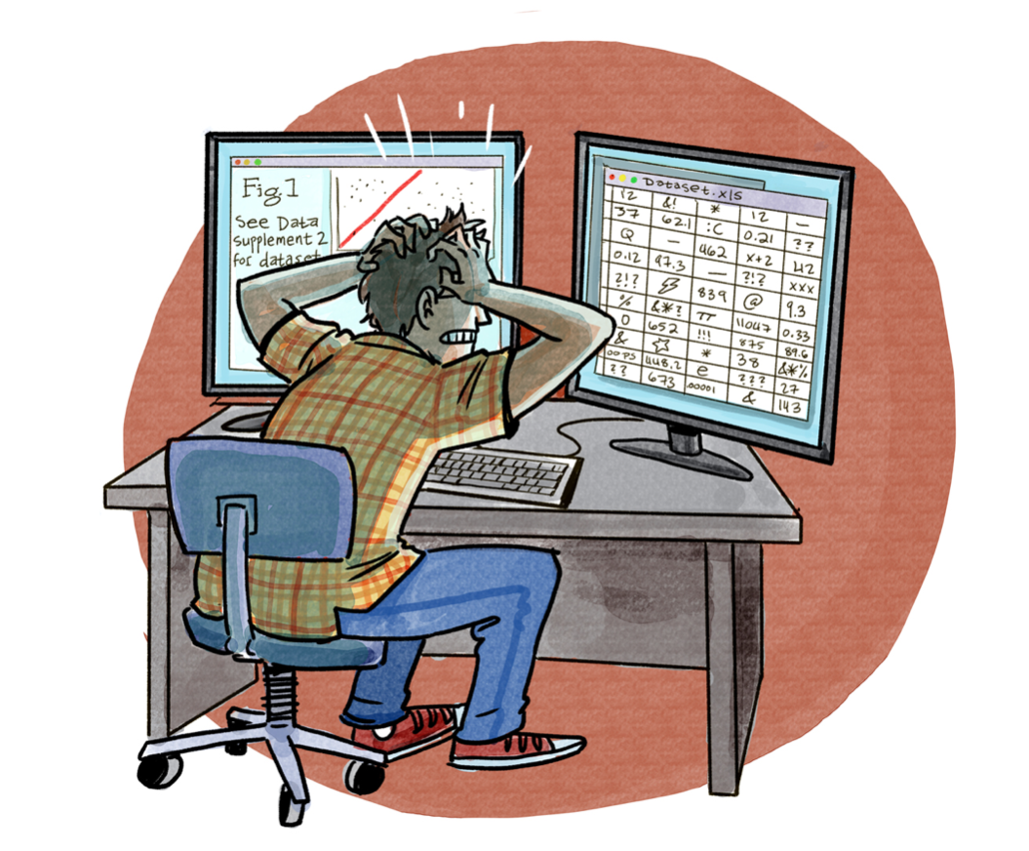
Data documentation
One of the most common reasons that researchers aren’t able to re-use a dataset (either someone else’s or even their own at a later date) is that they can’t understand it.
Read more about Documentation and metadata: https://www.cessda.eu/Training/Training-Resources/Library/Data-Management-Expert-Guide/2.-Organise-Document/Documentation-and-metadata
UBL | Centre for Digital Scholarship

Slide 14
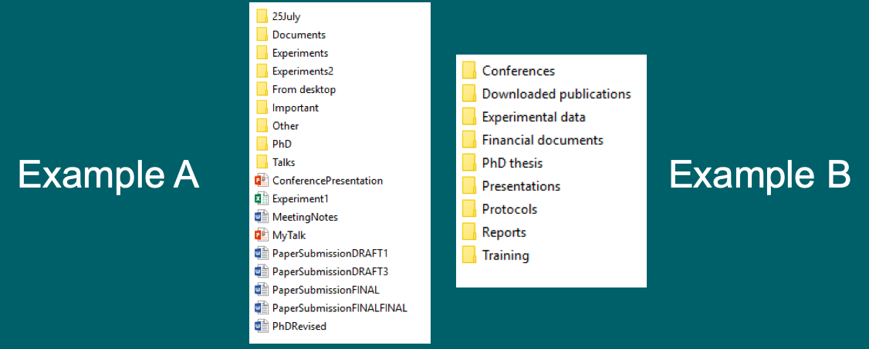
Data documentation: two simple ways
1. Clear organisation and file naming
❌
✅
UBL | Centre for Digital Scholarship

Slide 15
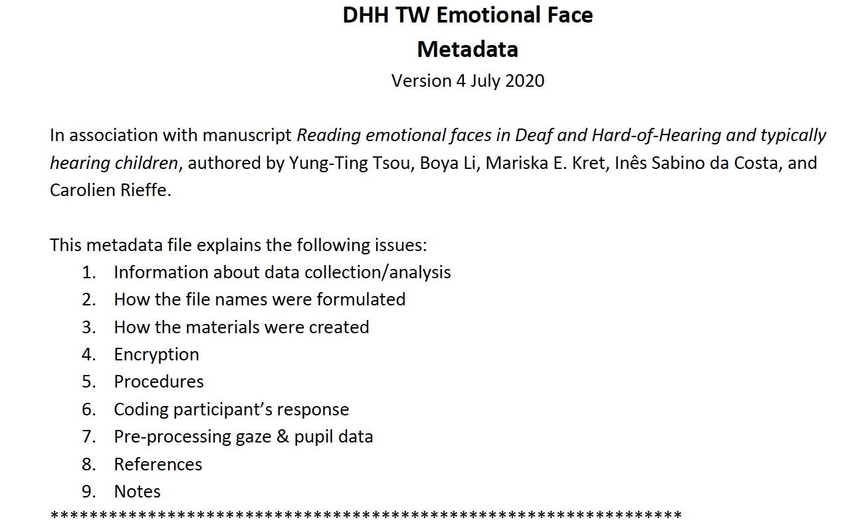
Data documentation: two simple ways
2. Comprehensive Readme file
Readme file from
Tsou, Yung-Ting, 2020, "Reading Emotional Faces in Deaf and Hard-of-Hearing and Typically Hearing Children",
https://doi.org/10.34894/0GWR9W, DataverseNL, V2
Read more about Readme files: https://data.research.cornell.edu/content/readme
UBL | Centre for Digital Scholarship

Slide 16
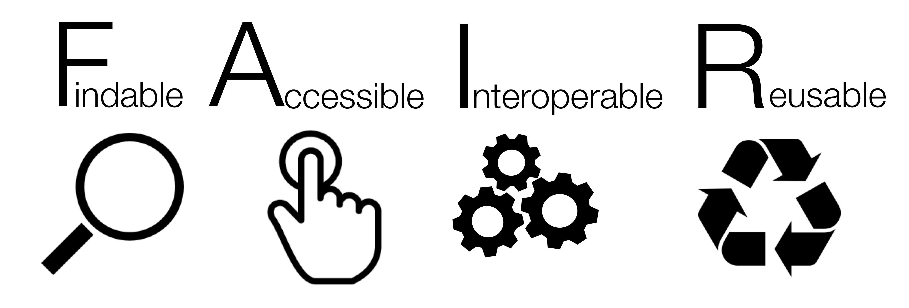
FAIR data exercise
Look up the articles below and complete the assignment on the next slide.
1. Achterberg, M., Dobbelaar, S., Boer, O.D. et al. Perceived stress as mediator for longitudinal effects of the COVID-19 lockdown on wellbeing of parents and children. Sci Rep 11, 2971 (2021). https://doi.org/10.1038/s41598-021-81720-8
2. Gaëtan Mertens, Lotte Gerritsen, Stefanie Duijndam, Elske Salemink, Iris M. Engelhard, Fear of the coronavirus (COVID-19): Predictors in an online study conducted in March 2020, Journal of Anxiety Disorders, Volume 74, 2020, 102258, ISSN 0887-6185, https://doi.org/10.1016/j.janxdis.2020.102258.
UBL | Centre for Digital Scholarship

Slide 17
FAIR data exercise
I. For each article, on a scale from 1-10, how would you score the FAIRness of the data?
Findable : How easy is it to find the data?
Accessible : How easy is it to access the dataset and the data?
Interoperable : Does the documentation help you to understand the data?
Re-usable : Does the license on the data allow reuse?
II. Discuss your scores in your group.
UBL | Centre for Digital Scholarship

Slide 18
Thank you
Centre for Digital Scholarship
Femmy Admiraal
0000-0002-3609-7073
f.admiraal@library.leidenuniv.nl

